Slide 1
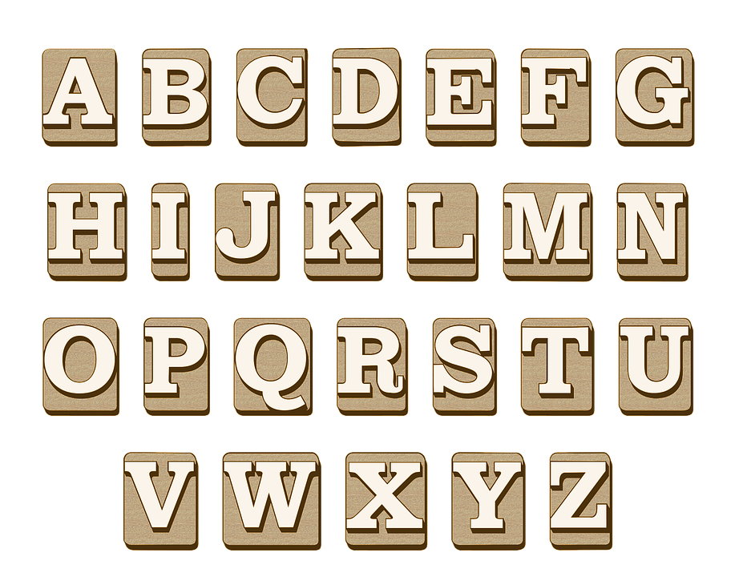
This presentation will provide an overview of how and what are CSS fonts, values and property. What are Font-family, Font-style, Font-size, and Google Font?
Introduction to CSS Fonts.

Slide 2
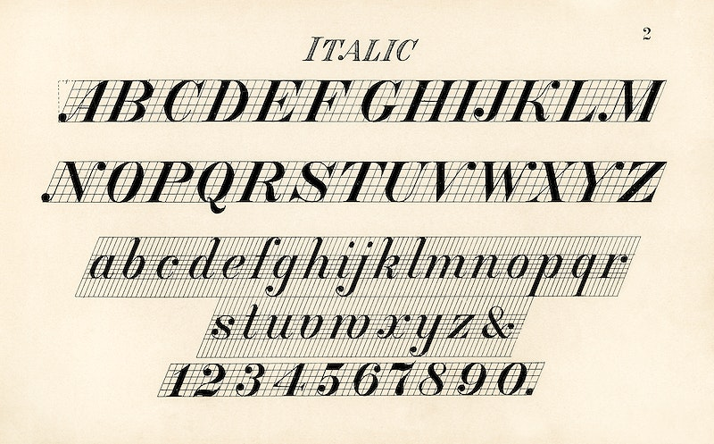
Types of fonts.
In CSS we have 5 types of font.
Serif
Monospace
Cursive
Fantasy

Slide 3
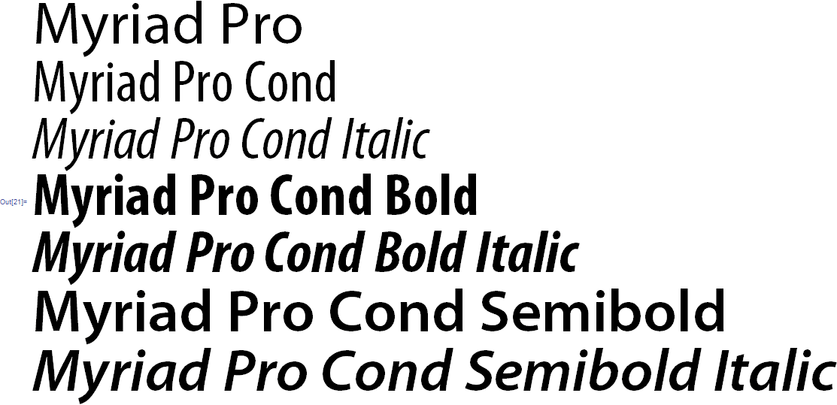
Font-family
Font-family is often formatted to have multiple fallback fonts that are more generic, therefore more likely supported by the users' browser.
Font-family is used to set text to a specific font, the styles of font vary greatly but often come under one of five categories:
Serif fonts have a small stroke at the edges of each letter.
Sans-serif fonts have clean lines (no small strokes attached)
Monospace fonts - here all the letters have the same fixed width
Cursive fonts imitate human handwriting
Fantasy fonts are decorative/playful fonts
This Photo by Unknown Author is licensed under CC BY-SA

Slide 4
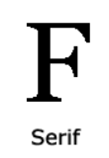
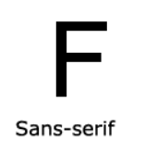
SERIF FONT:
FJN
Example:
Times New Roman Georgia Garamond
SANS-SERIF FONT:
Example:
Arial Verdana Helvetica

Slide 5
Font-style
Examples:
Font-style: normal (This is a paragraph in normal style )
Font-style: italic (This is a paragraph in italic style.)
Font-style: oblique: (This is a paragraph in oblique style.)
Font-style is used to dictate if the text will be:
Normal - text is not altered
Italic - text is shown sloped, often used for distinction
Oblique - text is shown slanted, similar to italic but less supported

Slide 6
Font-size
Font-size dictates generally how large each letter will be vertically
There are multiple ways that font-size can be denoted such as:
Pixels - exact size in pixels on screen;
Example: font-size: 40px;
EM - 1em is equal to the current font size which is often defaulted at 16 px;
Example: font-size: 2.5em; /* 40px/16=2.5em */
Percent - percent is the percent of the current font size similar to em;
Example: font-size: 100%; /* 16px*100%=16px */
VW - is a responsive size that is 1% of the current viewport width;
Example: font-size: 10vw; /* 10*1%viewport=10%viewport */

Slide 7
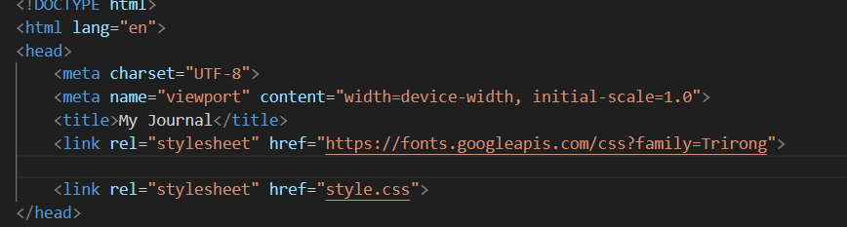
Google Fonts
Google fonts are fonts that are imported using a <link> tag
The link tag is formatted as <link rel="stylesheet" href="link to font">
You can find the link for a font on it's corresponding Google fonts page ( https://fonts.google.com/ ) by selecting which versions of the font you prefer.
After selecting the fonts you want to use on your site you can proceed to copy and paste the code it provides you with into your HTML head.
An example of it being used would look like:

Slide 8

Presentation By Tom and Eghosa.
This Photo by Unknown Author is licensed under CC BY-SA-NC

